Slide 1
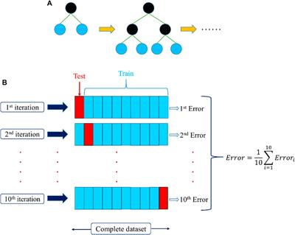
XG Boosting Regressor
→ Good performance as compared to all other machine learning algorithm
→ Builds sequential tree –learn & improve previous errors

Slide 2
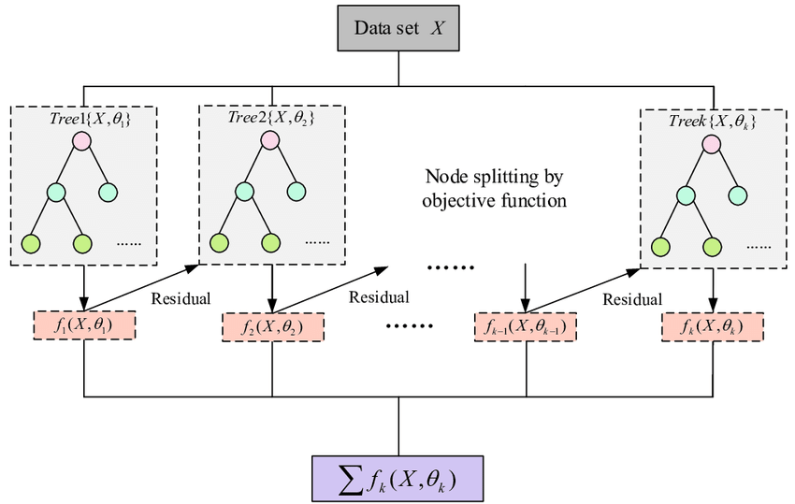
→ New models are created that computes the error in the previous model and then leftover is added to make the final prediction.

Slide 3
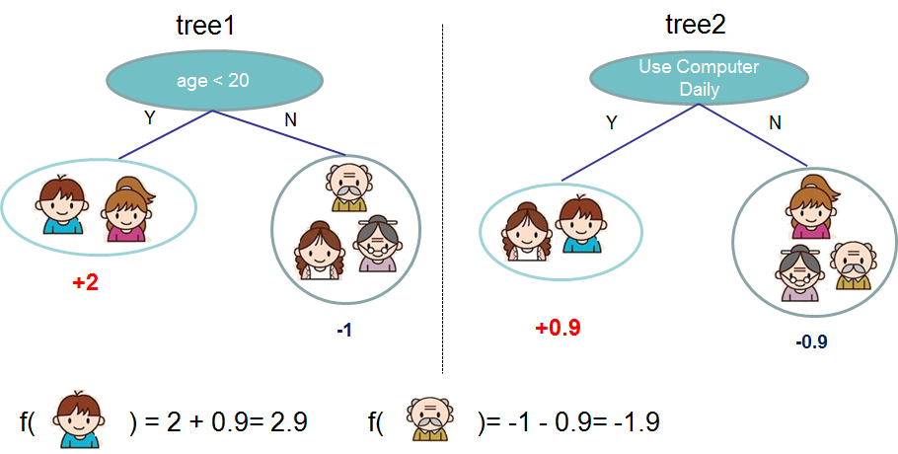
--> Prediction is Sum the scores of predicted by each tree

Slide 4
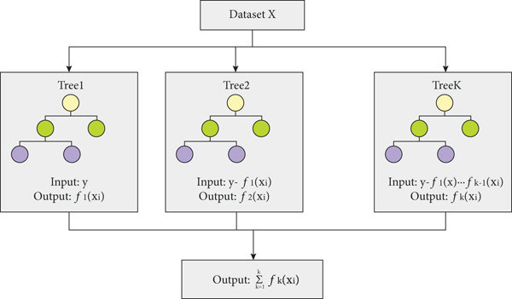

Slide 5
